Slide 1

OSCON 2010:
Introduction to Developing MeeGo Applications and Taking Advantage of the Intel Atom Developer Program & Intel’s AppUp Center
David Elfi
July 2010
Notes:
1

Slide 2

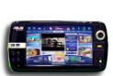

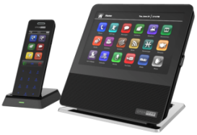
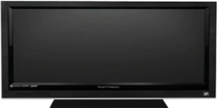





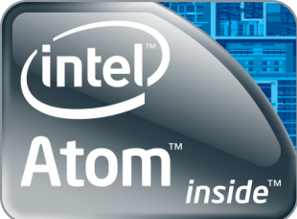
MeeGo*: One OS, Multiple Devices
Netbooks/
Entry level desktops
Connected TV
Handhelds/
Smartphones
Auto
Embedded
Intel® Atom™ Developer Program and
Intel AppUp℠ Center
OS &
Sys. Infra.
OS &
Sys. Infra.
OS &
Sys. Infra.
MeeGo = Moblin™ + Best of Maemo*
Platforms based on Intel® Atom™ processors
* Other names and brands may be claimed as the property of others.
Notes:
2
2
2
2
(first explain)
Intel and Nokia announced in February that they will bring the best of Moblin and Meemo together for the open source community; MeeGo will be that solution
Today the Intel Atom Developer Program and Intel AppUp Center suport Moblin v2.1 with the goal of applications being upward compatible when MeeGo is released.
(Then cover slide in: Multiple devices then bottoms up)

Slide 3
MeeGo Highlights
Target for Netbooks, Tablets, Smart Phones, embedded in devices with Application running on top of it
Multi platform system with a consistent use of Qt API
Similar UI experience for all the targets where the system is running
End consumers who like ease of use is the consumer target
Notes:
With a consistent use of QT API across

Slide 4
MeeGo Architecture
Linux based OS
X Window experience based on Qt, Clutter and GTK
Several developer toolsets:
  Communication Services
  Visual Services (2D and 3D)
  Multimedia Services based on Gstreamer
  Personal services oriented to end consumers (such as
  calendars, contacts, tasks)
Notes:
Put no too much emphasis on clutter and gtk

Slide 5
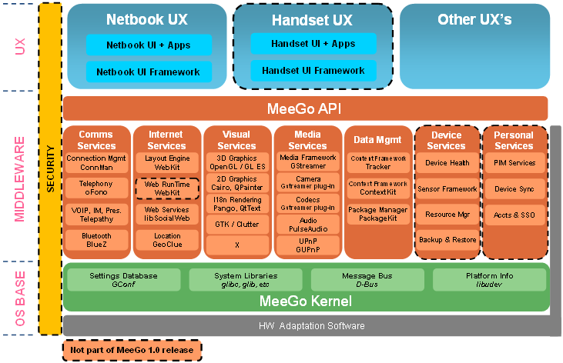
MeeGo Architecture

Slide 6





Intel App Store & Developer Program
“The best PC is the one you have”
  Netbooks simple, affordable companion PC
The time is right for the netbook
  40 million shipped; projected 2010 58M, ~139 million in 2013**
  Co-branded stores for OEMs
No software tailored to the netbook experience and context today
For developers and ISVs
  Tools, SDKs for MeeGo*, Windows*, and various runtimes
  New sales/distribution channel
Users
App Store
Developers &
Applications
Developer
Framework
Operating
Systems
Compatible
HW
Application innovation and a revenue share opportunity
* Other names and brands may be claimed as the property of others
**Source: ABI research, Netbooks, MIDs, and Mobile CE Market Data 2009
Notes:
(read notes instead of slide)
The Intel Atom Developer Program and Intel AppUp Center is an end to end economy.
Consumers have access to a rich catalog of applications . They have access to Intel’s store, but eventually co-branded OEM and Service Provider stores as well. They can buy apps once and run on up to 5 devices.
The Intel AppUp Center will enhance product and service offerings for OEMs and service providers, allow them to remain competitive across all segments and generate revenue. They are along for the ride, with skin in the game
Developers and ISVs reach a broad audience including OEM & Service provider customers while billing and licensing is covered by Intel. Additionally AppUp center supports native apps, no need to learn new languages or APIs. If runs well on Netbook shouldn’t be problems getting it in the store.

Slide 7
Importance for Developers
Develop for netbooks
# Port existing apps
# Build new, compelling experiences
Low friction
deployment
Easy validation
New distribution channel
# Distribute applications as well as
components to million of end consumers
Updates
Innovation
Objective
Advantage
Notes:
(slide builds read notes not slide)
Through the Intel Atom Developer Program, the ISV / developer can focus on developing innovated applications and driving income through innovative applications.
Intel takes care of the difficult tasks that ISVs and developers dread: validation and deployment.

Slide 8
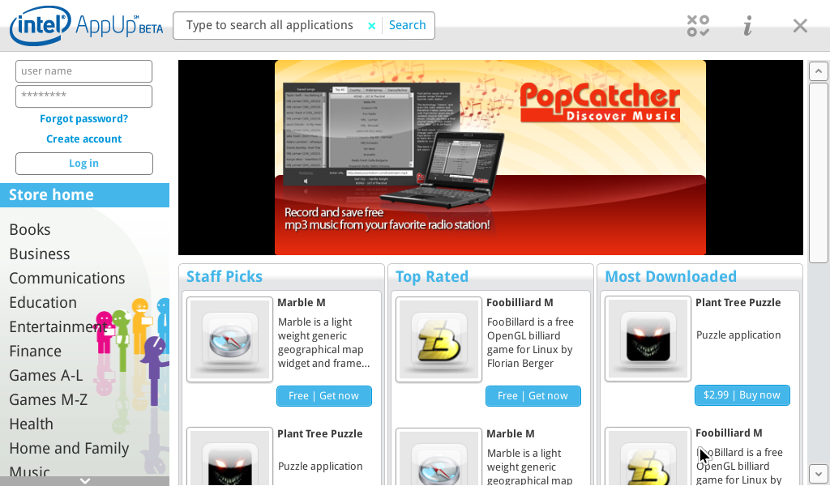
The Intel AppUp Center
Safe
Intel is a name that consumers and developers trust
Fast to Deploy
Simple graphical user interface makes netbooks desirable as an introduction to computing
Customizable
Consumers have easy access to their content, Affiliated Stores can control content for their store

Slide 9



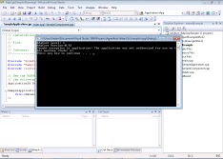

AppUp Architecture
Consumer
Store
Store UI
Application Distribution Service
Admin Web UI
Consumer Client
Store Backend Services
Developer Portal
Application Services
Developer
Existing Dev. Tools
Tools Utilities
Developer Dashboard
Runtime A
Runtime B
Application
Application
App Services
App Services
Emulator
IDE Integration
Notes:
We will start with a 10K feet view at IADP architecture.
The overall Intel Atom Development framework can be divided into three major sub-components:
Consumer
Developer
Store
The systems and interfaces relevant to the SDK are filled dark blue in the case of systems and thick lines in the case of communication.
More about each sub-system in the subsequent slides.
OCS Open Connect Services. KDE. Garage uses it. We did it in this way because of security or …
In case someone asks

Slide 10



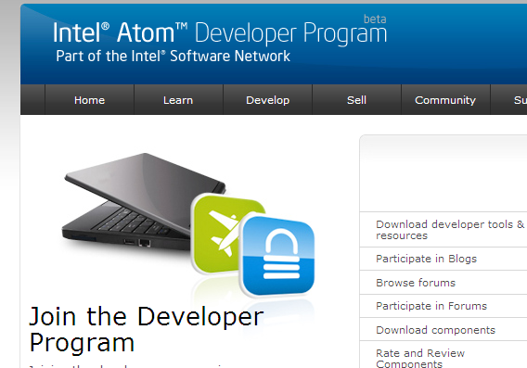


Development Cycle
Develop the application using SDK
Submit it into the Portal
App is validated
Go to production
Support it
Update

Slide 11
Initial SDK Services
Authorization
Application execution control
Component use control
Instrumentation
Compile applications statistical metrics
Crash Reporting
Registering all crashes
Attempting to collect crash data (such as call stack)
Reporting statistics and crash data on developer’s dashboard
Development Tools
IDE plugin (AppUp code generation wizard)
Various utilities to facilitate application’s testing, packaging and submission
Consolidate them into the backend and present information to the developer
Notes:
Development tools are going to be available in Q3. Under development
SDK is optional
Nokia OVI store, recompile it for MeeGo and you will be able to submit it in appstore.
Open source free application. If somebody takes and distribute it without paying does not care.
MeeGo compliance only if it is been asked. MeeGo sdk there isn’t and will be available to Q4 but not sure.

Slide 12

Development Considerations
Applications use SDK for Licensing service
Applications must use MeeGo compliant libraries as dependencies.
Applications must not use desktop manager specific arguments
There must be only one version of the application in official repositories.
Applications should be installed on /usr/share/applications.
Application icon installed in correct MeeGo menu category required.
Applications not necessary to be Open Source
Notes:
Applications use SDK for Licensing service
Applications must use MeeGo compliant libraries as dependencies.
Applications must not use desktop manager specific arguments (i.e. -caption %c).
There must be only one version of the application in official repositories.
Applications must be installed on /usr/share/applications.
Application executable must be binary.
Application icon installed in correct Moblin menu category not required.

Slide 13
SDK C++ Framework
Provides you with high-level C++ interface to Intel® Atom™ Developer Program
  Organizes APIs into object model and takes advantage of C++ features to reduce SDK integration complexity
Core types and classes declared in adpcppf.h, implemented in adpruntime[d].a and documented in SDK Developer’s Guide
All C++ Framework objects reside under com::intel::adp namespace
Core classes | Description
Application | Initializes IADP SDK internals and checks if application is authorized to run
Component | Checks if hosting application is authorized to use the component
AdpException | Provides base class functionality to all derivative IADP SDK exception classes
DefaultCrashReport | Provides a reference implementation of the crash report functionality

Slide 14
Sample: Application Authorization
Application *pApp = NULL;
try
{
// Create an instance of Application class, using DEBUG application ID
pApp = new Application( ApplicationId ( ADP_DEBUG_APPLICATIONID ) );
}
catch (AdpException& e)
{
cout << “Application not authorized to run. Exception : \n" << e.what() << endl;
if (pApp != NULL) delete pApp;
// Consider disabling your functionality or exiting an application here
}
// ... Your normal code flow continues here
Notes:
using IADP C++ interface (code snippet)

Slide 15
Sample: ComponentAuthorization
Component *pComp = NULL;
try
{
// Create an instance of Component class, using DEBUG component ID
pComp = new Component( ComponentId ( ADP_DEBUG_COMPONENTID ) );
}
catch (AdpException& e)
{
cout << “Application not authorized to use component. Exception : \n"
<< e.what() << endl;
if (pComp! = NULL) delete pComp
// Consider disabling your functionality here
}
// ... Your normal code flow continues here
Notes:
using IADP C++ interface (code snippet)

Slide 16

Validation Process
1Package Information: Get information about the package and verify if it is well formed.
2Install Application
3Check Application Executable: Executable files, command line parameters, permissions
4Application License: Needs to be in accordance to AppUp license
5Launch Application: Tries to launch the application.
6Application Icons: deployment in MeeGo categories
7Uninstall Application
8Accept the Package: expose the package to the users

Slide 17

Added Values
  Open source and non open source application development on top of a portable architecture
  Worldwide distribution channel, development support, low barrier to entry infrastructure, easy validation (Partners and OEMs look for the combination)
  Program is focused on netbooks now; will expand to other devices based on the Intel® Atom™ processor
  Infrastructure for supporting development and user feedback
  Monetization channel to developers who look for revenue

Slide 18
Where to Go
Intel Atom Developer Program
  http://appdeveloper.intel.com/en-us/
AppUp
  http://www.intel.com/appup/

Slide 19
Q&A

Slide 20
Backup

Slide 21
MeeGo SDK
Intended for any linux distribution
Works on top of a chroot environment
Based on QT 4.6
Toolset available:
  Communication Services: ConnMan, oFono, Telepathy
  Internet: WebKit
  Visual: OpenGL ES, Cairo and Qpainter
  Media: Gstreamer, PulseAudio
  Data: Tracker, PackageKit, ContextKit

Slide 22
Legal Disclaimer
INFORMATION IN THIS DOCUMENT IS PROVIDED IN CONNECTION WITH INTEL® PRODUCTS. EXCEPT AS PROVIDED IN INTEL’S TERMS AND CONDITIONS OF SALE FOR SUCH PRODUCTS, INTEL ASSUMES NO LIABILITY WHATSOEVER, AND INTEL DISCLAIMS ANY EXPRESS OR IMPLIED WARRANTY RELATING TO SALE AND/OR USE OF INTEL PRODUCTS, INCLUDING LIABILITY OR WARRANTIES RELATING TO FITNESS FOR A PARTICULAR PURPOSE, MERCHANTABILITY, OR INFRINGEMENT OF ANY PATENT, COPYRIGHT, OR OTHER INTELLECTUAL PROPERTY RIGHT. Intel products are not intended for use in medical, life-saving, life-sustaining, critical control or safety systems, or in nuclear facility applications.
Intel products may contain design defects or errors known as errata which may cause the product to deviate from published specifications. Current characterized errata are available on request.
Intel may make changes to dates, specifications, product descriptions, and plans referenced in this document at any time, without notice.
This document may contain information on products in the design phase of development. The information here is subject to change without notice. Do not finalize a design with this information.
Designers must not rely on the absence or characteristics of any features or instructions marked "reserved" or "undefined." Intel reserves these for future definition and shall have no responsibility whatsoever for conflicts or incompatibilities arising from future changes to them.
Intel Corporation may have patents or pending patent applications, trademarks, copyrights, or other intellectual property rights that relate to the presented subject matter. The furnishing of documents and other materials and information does not provide any license, express or implied, by estoppel or otherwise, to any such patents, trademarks, copyrights, or other intellectual property rights.
Wireless connectivity and some features may require you to purchase additional software, services or external hardware.
Performance tests and ratings are measured using specific computer systems and/or components and reflect the approximate performance of Intel products as measured by those tests. Any difference in system hardware or software design or configuration may affect actual performance. Buyers should consult other sources of information to evaluate the performance of systems or components they are considering purchasing. For more information on performance tests and on the performance of Intel products, visit Intel Performance Benchmark Limitations
Intel, the Intel logo are trademarks or registered trademarks of Intel Corporation or its subsidiaries in the United States and other countries.
*Other names and brands may be claimed as the property of others.
Copyright © 2010 Intel Corporation. All rights reserved.
22
Notes:
22

